Slide 1
BOOSTING ALGORITHMS

Slide 2
TYPES OF BOOSTING ALGORITHM
1.ADA BOOSTING
(Adaptive Boosting)
2.XG BOOSTING
(Extreme Gradient Boosting)
3.LG BOOSTING
(Light Gradient Boosting)

Slide 3
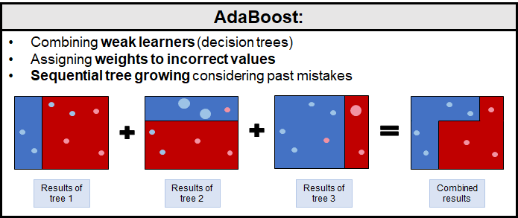
ADA BOOSTING
An Adaboost regressor is a meta estimator that begins by fitting a regressor on the original dataset and then fit additional copies of the regressor on the same dataset but where the weights of instances are adjusted according to the error of the current prediction.
In Simple words, It builds a model and gives the equal weights to all the data points. It then assigns higher weights to points that are wrongly classified or weaker points.
It commonly used estimator is decision trees with just one split. Which is called as decision stump.

Slide 4
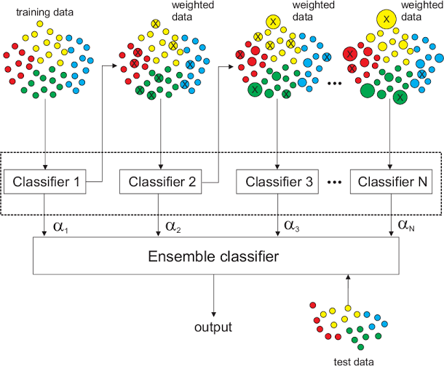
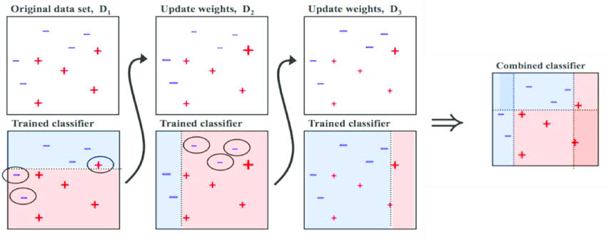
Schematic Diagram for Ada Boosting

Slide 5
Key Points
Ada boosting algorithm predictions from multiple weak learners, usually decision stumps to form a strong learner.
The weights of the samples are adjusted at each iteration.
This algorithm, training process starts with a decision stump. At every step, the weights of the training samples which are misclassified are increased for the next iteration. The next tree is built sequentially on the same training data but using the newly weighted training samples. This process is repeated until a desired performance is achieved.
Ada boost is a stage wise additive models (greedy algorithm), meaning new trees in the model are built without changing the previous existing trees.
The final model is formed by combining the predictions from individual trees through a weighted sum.
Ada boosting algorithm can be used for both Classification and Regression Problem.

Slide 6
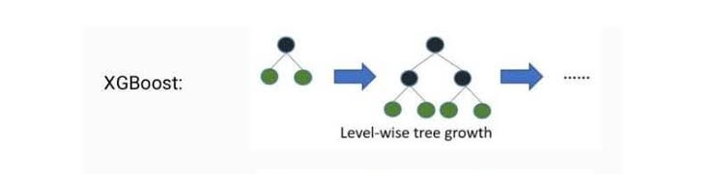
XG Boosting
The Extreme Gradient (XG) Boosting is used to produce a predictive model from an ensemble of weak predictive models.
Gradient boosting is a supervised learning algorithm, which attempts to accurately predict a target variable by combining the estimates of a set of simplifier, weaker models.
It is using the gradient boosted decision tree (GBDT). Which means the parallel or level wise tree growth and gradient boosting machine learning library.

Slide 7
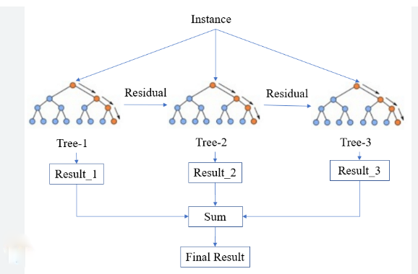
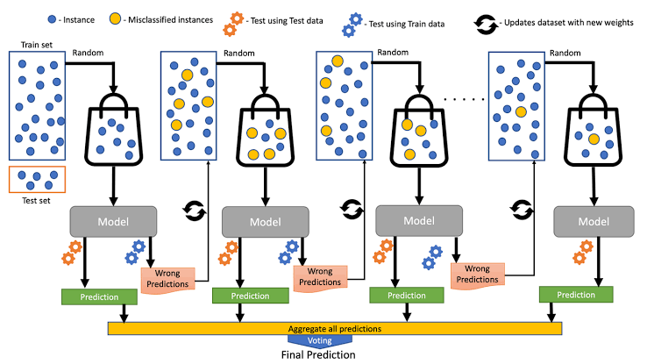
Schematic Diagram for XG Boosting

Slide 8
Key Points
XG boosting algorithm, predictions from multiple weak learners, usually decision stumps to form a strong learner.
No reweighting of the samples takes place in XGBM.
This algorithm, uses gradient descent to iteratively fit new weak learners to the residuals of the previous ones, minimizing a loss function.
XG boosting is a stage wise additive models (greedy algorithm), meaning new trees in the model are built without changing the previous existing trees.
The final model is an equal weighted sum of all of the individual trees.
XG boosting algorithm can be used for both Classification and Regression Problem.

Slide 9
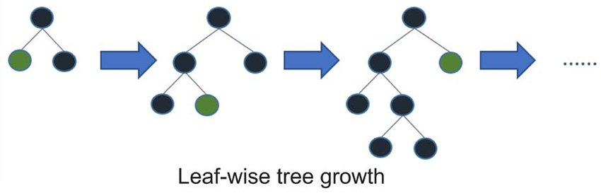
LG Boosting
Light Gradient Boosting algorithm is a gradient boosting framework designed for efficient and distributed training. It is particularly well suited for regression tasks where the goal is to predict a continuous numerical value
It is using the gradient based one side sampling (GOSS). Which means the decision tree growth in one side or leaf wise tree growth and gradient boosting machine learning library.

Slide 10
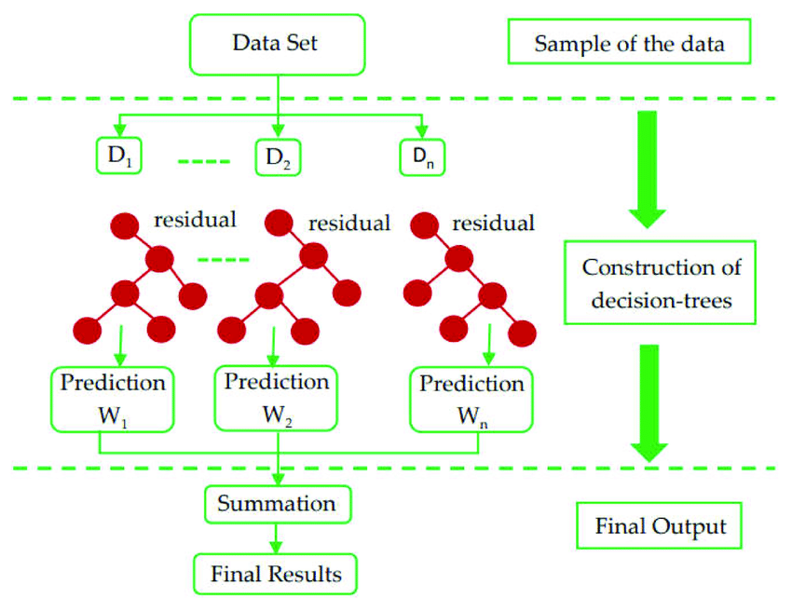
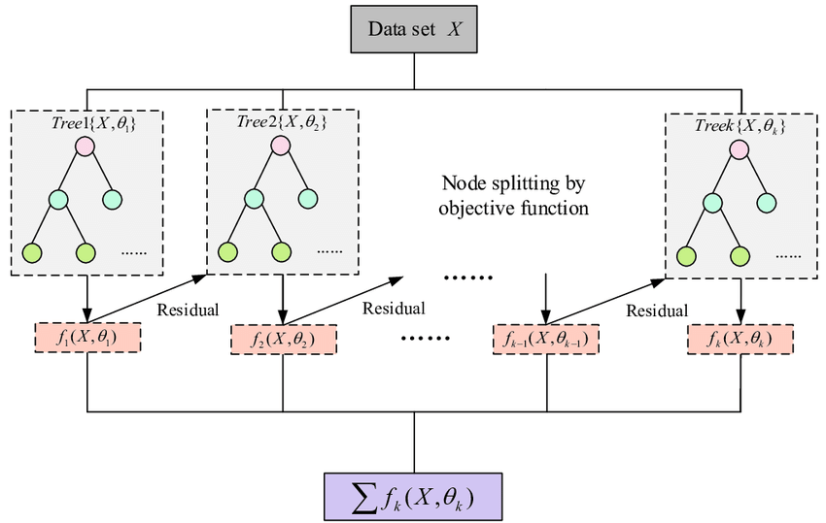
Schematic Diagram for LG Boosting

Slide 11
Key Points
LGBM grows tree vertically while other algorithm grows trees horizontally meaning that Light GBM grows tree leaf-wise while other algorithm grows level-wise.
It will choose the leaf with max delta loss to grow. When growing the same leaf, Leaf- wise algorithm can reduce more loss than a level-wise algorithm.
It can handle categorical features naturally without requiring one-hot coding.
It reduces the need for processing steps, making it convenient for real world dataset. It is known for its efficient training speed.
It consumes limited memory. It is highly efficient with large datasets.
The final model is an equal weighted sum of all of the individual trees.
XG boosting algorithm can be used for both Classification and Regression Problem.

